Slide 1

BC3409 AI in Accounting and Finance Lecture 3: Neural Network 2
Teoh Teik Toe
ITOM/NBS
ttteoh@ntu.edu.sg
Aug 2020
97905202

Slide 2
Class Plan
Lecture + Practical (1.5hours)
15mins break
Exercise (1.5hours)
15mins break
Presentation and Discussion (0.5 hours)
Week 1,2 & 3 do not have presentation

Slide 3
Weekly Plan
Introduction to AI & Installing Python and R
Neural Network 1 (PA)
Neural Network 2 (PA)
Weka (PA & Project)
Chatbot 1 (Project)
Chatbot 2 (Project)
RPA 1 (Project)
RPA 2 (Project)
Practical Assessment Review
Project Review
Block Chain (Project)
Deep Learning – Tensor Flow LSTM GAN & Reinforcement Learning
Project Presentation

Slide 4
Video Recording
Regression (PA) – Video
Decision Tree (PA) – Video
Text Analytics - Video
Accounting and Finance knowledge – Video
Pre-Requisite : BC2406

Slide 5
Objective of this class – Domain Knowledge
Financial Management
Management Accounting
Financial Accounting

Slide 6
Objective of this class – Domain Knowledge
Analytics
Prediction
Automation

Slide 7
Objective of this class – Skill Knowledge
Neural Network
Chatbot
RPA

Slide 8
E-Learning Week
To Be Confirm

Slide 9
Consultation
S3 B2 C110
65148988/97905202/ttteoh@ntu.edu.sg
Wednesday 130pm to 330pm
Optional (by Appointment)
Tuesday 11am to 1pm
Thursday 11am to 1pm
Or any other timing

Slide 10
Most Importantly …..
Component | Weightage | Team/Individual
Class Participation | 15 | Individual | Week 1 to 13
Practical Assessment | 40 | Individual | Week 10
Individual Project | 30 | Individual | Week 12 (Video Clip)
Group Project & Presentation | 15 | Team | Week 13 (Video Clip & 15 mins Presentation for each group)
Total | 100%

Slide 11
Type of activation function | Number of neurons | Number of hidden layers | Number of epochs | Dropout | Accuracy
relu | 10 | 2 | 5 | 0.2 | 49%
Relu | 50 | 2 | 10 | 0.2 | 66%
Relu | 10 | 3 | 100 | 0.2 | 68%
Relu | 15 | 3 | 300 | 0.2 | 71%
Relu | 20 | 1 | 300 | 0.3 | 71%
relu | 15 | 1 | 300 | 0.2

Slide 12
Mark Distribution
Participation 15%
Discussion 5%
Chatbot Presentation 5% (Week 6)
RPA Presentation 5% (Week 8)
Individual Project 30%
Project Plan 5% (Week 5)
Final Report 20% (Week 12)
Group Project 15%
Project Plan 5% (Week 9)
Final Report 10% (Week 13)
Practical Assessment 40% (Week 10)

Slide 13
Current Courses
Statistic AB1202
Data Management BC2402
Business Analytics BC2406 2407
Artificial Intelligence BC3409
AI Model DropBox:
https://www.dropbox.com/sh/m03zs4hd497rnk7/AABZ_o5g1MHKE7wUvvXYPWACa?dl=0

Slide 14
Agenda
Neural Network Using Python Keras
Compile
Fit – Training
Evaluation – Testing
Prediction – Confusion matrix

Slide 15

Keras
Keras is an open-source neural-network library written in Python.
It is capable of running on top of TensorFlow, Microsoft Cognitive Toolkit, R, Theano, or PlaidML.
Its primary author and maintainer is François Chollet, a Google engineer.
In 2017, Google's TensorFlow team decided to support Keras in TensorFlow's core library.

Slide 16

TensorFlow
TensorFlow is a free and open-source software library for dataflow and differentiable programming across a range of tasks. It is a symbolic math library and is also used for machine learning applications such as neural networks.
TensorFlow was developed by the Google Brain team for internal Google use. It was released under the Apache License 2.0 on November 9, 2015.

Slide 17
Install Keras
Requirement
Python 3.5 (Window Tensorflow only support 3.5)
Tensorflow (CPU or GPU both are ok)
Numpy
All the above can be installed through pycharm(recommended for easy installation)

Slide 18
Step in running a Keras program
Typically
Make sequential model
Add layer
Add compile function, which contains loss function and optimizer
Add how many times to train
Evaluate after training
Prediction on Test Set

Slide 19
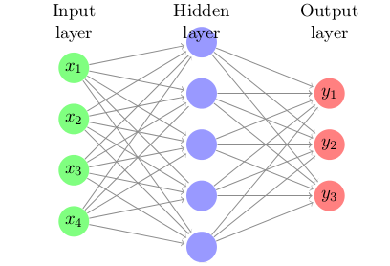
Keras Sequential
Sequential is a linear stack of layers
This is use most of the time
Model that use sequential
LSTM, RNN
model = Sequential()

Slide 20
Keras Adding Layer
Example
model.add(Dense(12, input_dim=8, activation='relu'))
Dense is a regular Neural Network layer
Other layer are available, LSTM, RNN

Slide 21
Keras Compile
We now have to specify what type of loss function to use
Also the gradient descend which is the optimizer
Example
model.compile(loss='binary_crossentropy', optimizer='adam', metrics=['accuracy'])

Slide 22
Keras Fit
We have to train the data.
Example
model.fit(X, Y, epochs=150, batch_size=10)
Where X, and Y are numpy array

Slide 23
Keras Evaluate
After training we want to check the accuracy
Example
scores = model.evaluate(X, Y)
print("\n%s: %.2f%%" % (model.metrics_names[1], scores[1]*100))

Slide 24
Keras Prediction
Final step, we predict the accuracy on the test set.
Example
predictions = model.predict(X)
print(predictions)
print('predictions shape:', predictions.shape)
y_pred = (predictions > 0.5)
y_pred=y_pred*1 #convert to 0,1 instead of True False
matrix = confusion_matrix(Y, y_pred)
print(matrix)

Slide 25
Run Example
Simple example that show case the usability and user friendliness
Able to be modified and added more layers or use different activation

Slide 26
# Create your first MLP in Keras
from keras.models import Sequential
from keras.layers import Dense
from sklearn.metrics import classification_report, confusion_matrix
import numpy
# fix random seed for reproducibility
numpy.random.seed(7)
# load pima indians dataset
dataset = numpy.loadtxt("pima-indians-diabetes.csv", delimiter=",")
# split into input (X) and output (Y) variables
X = dataset[:,0:8]
Y = dataset[:,8]
# create model
model = Sequential()
model.add(Dense(10, input_dim=8, activation='relu'))
model.add(Dense(10, activation='relu'))
model.add(Dense(1, activation='sigmoid'))

Slide 27
# Compile mode
# https://www.tensorflow.org/guide/keras/train_and_evaluate
model.compile(loss='binary_crossentropy', optimizer='adam', metrics=['accuracy'])
# Fit the model
model.fit(X, Y, epochs=1, batch_size=10)
# evaluate the model
scores = model.evaluate(X, Y)
print(scores)
print("Keras: \n%s: %.2f%%" % (model.metrics_names[1], scores[1]*100))
predictions = model.predict(X)
print(predictions)
print('predictions shape:', predictions.shape)
y_pred = (predictions > 0.5)
y_pred=y_pred*1 #convert to 0,1 instead of True False
matrix = confusion_matrix(Y, y_pred)
print(matrix)

Slide 28

Prediction Result

Slide 29
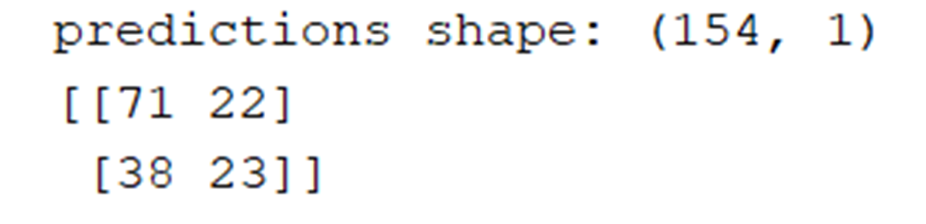
Exercise 1
Run the program and look at the confusion matrix
What is the accuracy?

Slide 30
Exercise 2 Activation Function
Try different parameter
model.add(Dense(10, input_dim=8, activation='relu'))
model.add(Dense(10, activation='relu'))
model.add(Dense(1, activation='sigmoid’))
Try change relu to sigmoid and see if any difference in the results
Write down the accuracy, which one is the highest?

Slide 31
Exercise 3 # of neurons in hidden layer
Try different parameter
model.add(Dense(10, input_dim=8, activation='relu'))
model.add(Dense(10, activation='relu'))
model.add(Dense(1, activation='sigmoid’))
Try change hidden layer neuron to sigmoid and see if any difference in the results
Write down the accuracy, which one is the highest?

Slide 32
Exercise 4 Hidden Layer
Try different parameter
model.add(Dense(10, input_dim=8, activation='relu'))
model.add(Dense(10, activation='relu'))
model.add(Dense(1, activation='sigmoid’))
Try add and remove hidden layer by adding or removing model.add and see if any difference in the results
Write down the accuracy, which one is the highest?

Slide 33

Exercise 5 Compile – Losses
# Compile mode
#https://www.tensorflow.org/guide/keras/train_and_evaluate
model.compile(
optimizer=keras.optimizers.RMSprop(), # Optimizer
loss=keras.losses.SparseCategoricalCrossentropy(from_logits=True), # Loss function to minimize
metrics=['sparse_categorical_accuracy’] # List of metrics to monitor
)
model.compile(
optimizer='adam’,
loss='binary_crossentropy’,
metrics=['accuracy'])

Slide 34
Exercise 5 Compile – Losses
What are losses?
Recall the goal of the neural network is to minimize the errors from the prediction and actual target across the dataset
Losses are the formula used to compute these errors
So that the losses (error) can be used to compute to update the weights of neuron
This is WHAT you want to optimize. → minimize error

Slide 35
Exercise 5 Compile – Losses
Losses:
MeanSquaredError()
KLDivergence()
CosineSimilarity()
etc.

Slide 36
Exercise 5 Compile – Losses
Important losses to know:
Root mean squared error (Continuous)
Binary cross entropy (Discrete for 2 classes eg. Dog vs Cat)
Categorical cross entropy​​ (Discrete for >2 classes eg. Dog vs Cat vs Monkey)

Slide 37
Exercise 5 Compile – Losses
Root mean squared error (Covered in Analytics 1)
Binary cross entropy (Discrete for 2 classes eg. Dog vs Cat) (Covered today in detail)
Categorical cross entropy​​ (Discrete for >2 classes eg. Dog vs Cat vs Monkey) (Self-reading. Concept similar to binary cross entropy. Email me if you have questions)

Slide 38

Exercise 5 Compile – Losses
Some intuition (for example in classifying apple (1) and orange(0))
Look at this in 3 cases
Model predict Apple (1) but is Orange (0)
Model predict Orange (0) but is Orange (Apple)
Model predict Apple (1) and is Apple (1)
Model predict Orange (0) and is Orange (0)
Model is not confident P(Yi) = 0.5

Slide 39
Exercise 5 Compile – Losses
Apple → 1 , Orange → 0
Model predict Apple (1) but is Orange (0) – similar to case 2
P(yi) → high (0.8)
Yi → 0
Becomes 0
(1 – yi) → 1
Part 2→ Becomes high Log(0.2) > Log(0.8) in magnitude
Conclusion: Predict wrongly → Error is large → Huge changes is made to weights with backpropagation → New result is very different which is good!

Slide 40
Exercise 5 Compile - Losses
Apple → 1 , Orange → 0
Model predict Apple (1) and is Apple (1) – similar to case 4
P(yi) → high (0.8)
Yi → 1
Becomes low
Log(0.8) is lower in magnitude than Log(0.2). Compare with previous slides
(1 – yi) → 0
Part 2 become 0 since you multiply by 0
Conclusion: Predict correct → Error is small→ Small changes is made to weights with backpropagation → New result is similar which is good!

Slide 41
Exercise 5 Compile – Losses
Apple → 1 , Orange → 0
Model is not very sure of prediction. P(Yi) = 0.5
P(yi) → (0.5)
Yi → 1
Log(0.5) = 0.301
(1 – yi) → 0
Part 2 become 0 since you multiply by 0
Conclusion: Unconfident model will be penalised as well but less compared to when model is wrong → weights will be modified and there might be different result

Slide 42
Exercise 5 Compile – Optimizer, Losses, Metrics
# Compile mode
#https://www.tensorflow.org/guide/keras/train_and_evaluate
model.compile(
optimizer=keras.optimizers.RMSprop(), # Optimizer
loss=keras.losses.SparseCategoricalCrossentropy(from_logits=True), # Loss function to minimize
metrics=['sparse_categorical_accuracy’] # List of metrics to monitor
)
model.compile(
optimizer='adam’,
loss='binary_crossentropy’,
metrics=['accuracy'])

Slide 43
Exercise 6 Compile – Optimizers
What are Optimizers?
Recall the goal of the neural network is to minimize the errors from the prediction and actual target across the dataset
Losses are the formula used to compute these error
Optimizer is HOW you want to UPDATE YOUR WEIGHTS. → minimize error

Slide 44
Exercise 6 Compile – Optimizer
Optimizer – Learning Rate (0.001)
Loss – Type of error measurement (RMSE)
Metrics – Accuracy, Specificity

Slide 45
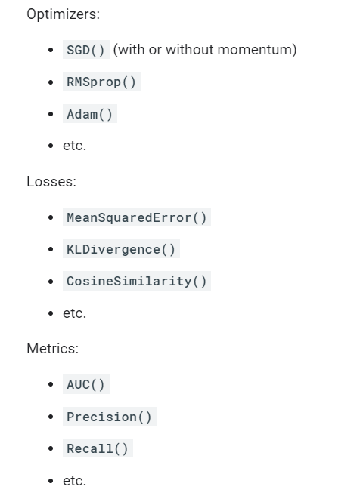
Exercise 6 Compile – Optimizer
model.compile(
loss='binary_crossentropy', optimizer='adam', metrics=['accuracy’]
)

Slide 46
Exercise 6 Compile – Optimizer
What is Optimizer? What does optimizer='adam’ means?
An optimizer is one of the two arguments required for compiling a Keras model
SGD
RMSprop
Adam
Adadelta
Adagrad
Adamax
Nadam
Ftrl

Slide 47
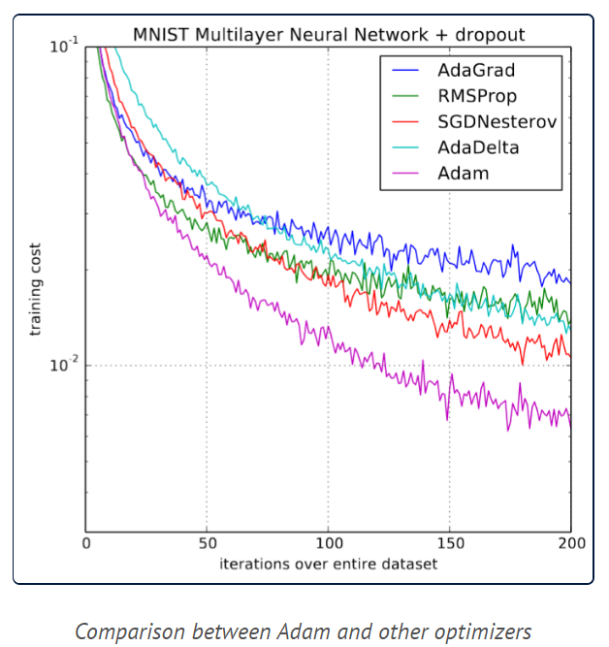
Exercise 6 Compile Optimizer
tf.keras.optimizers.Adam(
learning_rate=0.001,
beta_1=0.9,
beta_2=0.999,
epsilon=1e-07,
amsgrad=False,
name="Adam",
**kwargs
)
tf.keras.optimizers.Adamax(
learning_rate=0.001, beta_1=0.9, beta_2=0.999, epsilon=1e-07, name="Adamax", **kwargs
)

Slide 48
SGD – stochastic gradient descent
A few samples are selected randomly instead of the whole data set for each iteration.
In Gradient Descent, there is a term called “batch” which denotes the total number of samples from a dataset that is used for calculating the gradient for each iteration

Slide 49
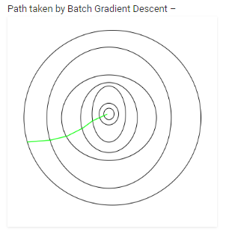
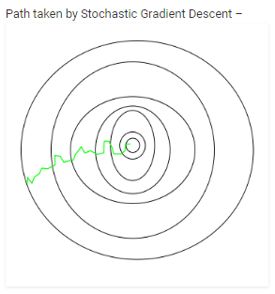
SGD – stochastic gradient descent
Effects:
Computationally much less expensive than typical batch Gradient Descent.
Takes a higher number of iterations to reach the minima, because of its randomness (path taken is wrigglier)
Both batch and SGD reach same destination (minima) but how they reach is different

Slide 50
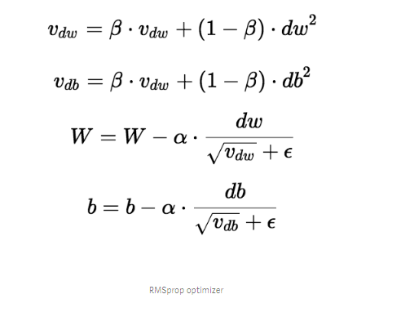
RMSprop
What is db vs dw?
Linear regression: y = mx +C
In neural network, constant is denoted as b
Db ← derivative of error wrt constant
Dw ← derivative of error wrt weights
Gradient descent discussed in Week 2
→ updated with after deducting gradient
→ Hence the name gradient descent

Slide 51
RMSprop
Why do you need B and (1-B)?
Give a weighted average and you give more importance to current derivative than past derivative
Why do you square dw and sqrt later?
You square because you are doing a square root operation at the bottom. Squaring also makes sure that number is positive. To a certain extent, this makes our number close to 1 for large dw. What about small derivative (Dw is small i.e 0.00001)?
What is Vdw ?
Previous derivative are stored and accounted for here. This is also commonly referred to as "momentum".
Current derivative / gradient

Slide 52
RMSprop
Current derivative / gradient
What is dw(sq) and what does it do?
Intuition:
Suppose your starting weight 0 and doing SGD.
First derivative is 100
2nd derivative is -70
3rd derivative is 90 ….
Your weights become
[100 → 30 → 120] and have a lot of fluctuations
With RMSprop, you smooth out these fluctuations because you store previous weights.
First change to weight is 100 but 2nd change in weight is weighted average so it would become more than -70, maybe –20 in changing the neural network's weights? Try calculating yourself using the formula! RMSprop helps to find the best weights more quickly and efficiently.
Conclusion: Optimiser is how to update your weight.​
​

Slide 53
RMSprop
Current derivative / gradient
Why do we see epsilon in some formula and not in others?
Suppose if your gradient is very small ie. 0.000000000001.
Any number divided by this number can really blow up become very big and this can result in continued huge fluctuations as vdw is carried into next iteration.
Epsilon is a small value you add to the formula to prevent weights from blowing up. Try it.

Slide 54
Exercise 6 Compile - Optimizer
Adamax – Can you figure out how it works and identify similar techniques used in RMSprop?
t += 1
m = beta1 * m + (1 - beta) * g
v = max(beta2 * v, abs(g))
current_lr = learning_rate / (1 - beta1 ** t)
w = w - current_lr * m / (v + epsilon)

Slide 55
Exercise 7 Compile - metrics
# Compile mode
#https://www.tensorflow.org/guide/keras/train_and_evaluate
model.compile(
optimizer=keras.optimizers.RMSprop(), # Optimizer
loss=keras.losses.SparseCategoricalCrossentropy(from_logits=True), # Loss function to minimize
metrics=['sparse_categorical_accuracy’] # List of metrics to monitor
)
model.compile(
optimizer='adam’,
loss='binary_crossentropy’,
metrics=['accuracy'])

Slide 56
Exercise 7 Compile - metrics
What are metrics?
Recall the goal of the neural network is to minimize the errors from the prediction and actual target across the dataset
Metrics is to evaluate your model and determine if its good.
** Can be same as loss function but they mean different thing.

Slide 57
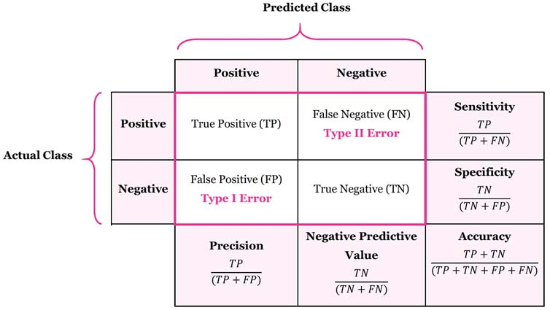
Exercise 7 Compile - metrics

Slide 58
Exercise 8 : Train on train set
model.fit(x_train, y_train, batch_size=64, epochs=3)
Please try to change the batch size and epoch
Batch size is a term used in machine learning and refers to the number of training examples utilised in one iteration
An epoch refers to one cycle through the full training dataset.
Try changing the batch size and epochs.
Write down the accuracy, which one is the highest?

Slide 59
Exercise 9: Evaluation and predict on Test Set
model.evaluate(test_dataset)
{'loss': 0.1302270144224167, 'sparse_categorical_accuracy': 0.9611999988555908}
predictions = model.predict(X_test)
print(predictions)
print('predictions shape:', predictions.shape)
y_pred = (predictions > 0.5) #set treshold
y_pred=y_pred*1 #convert to 0,1 instead of True False
matrix = confusion_matrix(y_test, y_pred)
print(matrix)
How to improve the model?

Slide 60
Discussion 30mins
Compare R NNet with Python Keras
Form your group
Think of an idea for your project

Slide 61
Summary
Learn how to
How to define neural network in Keras.
How to compile a Keras model using the efficient numerical backend.
How to train a model on data.
How to evaluate a model on data.
How to predict the test data.

Slide 62
Thank You

